Slide 1

Winter 2022
Welcome to
Digital Forensics
Instructor: Dr. Xiaodong Lin
Notes:
Welcome to Digital Forensics.
I am Professor Xiaodong Lin, your instructor for this course.

Slide 2
Prior knowledge and skill
Knowledge of operating system (OS), data structures and computer algorithms, computer network, cryptography and network security.
Notes:
I expect anyone who takes this course has a good knowledge of operating system (OS), data structures and computer algorithms, computer network, cryptography and network security.

Slide 3

Claim
Before I proceed, I would like to make it clear about the topic I gonna deliver, I'm not here to talk about
How to secure computer and network
I'm here to talk about
scientific investigatory techniques to crimes (or cyber attacks) involving electronic devices and why digital forensics is important to the society
3
Notes:
Before I proceed, I would like to make it clear about the topic I gonna deliver, I'm not here to talk about
How to secure computer and network, though these two topics are very overlapped in some areas.
I'm here to talk about
scientific investigatory techniques to crimes involving electronic devices and why digital forensics is important to the society.
Of course, it is very important that students have a good knowledge of computer and network security.

Slide 4
How to do well in this course?
4
Notes:
How to do well in this course?

Slide 5

Be Interested.
First and foremost
Let’s Work Together!
5
Notes:
The most important thing is you are interested in learning digital forensics.
Therefore, I have developed some interesting hands-on exercise so you can have lots of fun when doing them.
Hopefully I can inspire you to learn more digital forensics.
So let us work together this winter, having fun while studying digital forensics.

Slide 6
Course logistics
Lectures:
Time: Wednesday, 8:00AM - 8:45AM, 8:50AM - 9:35AM
Where: Cyberspace
6
Notes:
Next, I will talk about course logistics.
Our lectures will be held virtual.
There are two 45-min lecture each week, on Wednesday from 8:00am to 9:35am.

Slide 7

Course logistics (cont’d)
Please turn your videos off during lectures.
Please mute unless you're asking questions.
Please “Raise Your Hand” in Tencent Meeting if you have anything that requires immediate attention from me during lectures.
I will hold question and discussion sessions in the last 10 min of each lecture. So you can ask questions verbally or post your questions into chat box.
Be mindful, respectful of others. Please limit the use of chat box to course related materials only.
7
Notes:
For the online lectures, I also have some policy which I would like to ask your favor to follow them.
So please turn your videos off during lectures.
Also, please mute unless you're asking questions. Please “Raise Your Hand” in Tencent Meeting if you have anything that requires immediate attention from me during lectures. I will hold question and discussion sessions in the last 5 min of each lecture. So you can ask questions verbally or post your questions into chat box.
Be mindful, respectful of others. Please limit the use of chat box to course related materials only.

Slide 8
Course logistics (cont’d)
TA
Jianpeng Wang
Office hours:
TBD
Office:
office: TBD
Notes:
Thanks to Zhejiang University, and our class has TA, Jianpeng Wang.

Slide 9
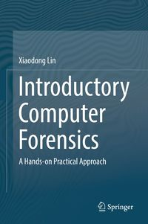

Textbook
Xiaodong Lin, Introductory Computer Forensics: A Hands-on Practical Approach, November 2018, Springer
(Freely available from Springer via Zhejiang University network at the following link
https://www.springer.com/gp/book/9783030005801)
Recommended References, Reading Materials, and On-line Articles
9
Notes:
We do have a textbook for this course, which is written by me. This book stems from the digital forensics course I developed in several Canadian universities.
I know the textbook is very expensive, but you don’t have to worry if you cannot afford the book. You can download an e-copy of the book from Springer via your university network at the web link provided here
https://www.springer.com/gp/book/9783030005801
In addition, I will provide very detailed lecture notes, and also try my best to explain the concepts as clearly as possible
Also, I will introduce some reading materials, and on-line articles in the end of each lecture notes.

Slide 10

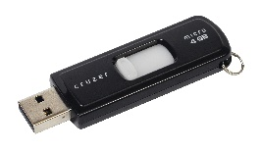
Course logistics (cont’d)
Hands-on Exercises
System requirements:
8 GB RAM, 25 GB hard disk free space.
a webcam, microphone, and speaker. A USB flash drive (small size is preferred, e.g., 8GB or smaller) is required for practice.
Virtual Machine Software: Install VirtualBox and its matching Extension Pack if you haven't already.
Note that if you already have VMware (e.g., VMware Workstation) installed, you can continue to use it as your virtualization platform.
Kali Linux Virtual Machine Image: Please use the following link to download a pre-built Kali Linux virtual machine image. All the hands-on exercises use this image.
https://www.offensive-security.com/kali-linux-vm-vmware-virtualbox-image-download/
10
Notes:
Next, I want to spend some time in talking about system requirements for your hands-on exercises.
It is best to have a computer or laptop with 8 GB RAM, 25 GB hard disk free space. Also, you will need a webcam, microphone, and speaker. A USB flash drive (small size is preferred, e.g., 4GB or smaller) is required for practice.
Also, please have VirtualBox installed as well as its matching Extension Pack if you haven't already.
Note that if you already have VMware (e.g., VMware Workstation) installed, you can continue to use it as your virtualization platform.
Also, we will use a pre-configured Kali Linux Virtual Machine Image. Please use the link provided here to download it. All the hands-on exercises use this image.

Slide 11


Theory
Digital Forensics
Practical, hands-on experience
+
Understand concepts and technologies
Learn about latest research from the literature
become familiar with a wide variety of digital forensic tools
Notes:
What do we do in Digital Forensics?
First, we study theory. So you must understand digital forensic concepts and technologies.
Also, as a graduate student, you will need to learn about latest research from the literature
Afterwards, you will build up practical, hands-on experience, and become familiar with a wide variety of digital forensic tools. Since you have a good knowledge of theoretical concepts, so you know how digital forensic investigations are technically carried out. Thus, You learn how these digital forensic tools are technically designed, and as a result, you should be able to design and develop your own digital forensic tools.

Slide 12
Claim
Information provided here and all in-class demonstrations are designed for the purpose of education, but not for any illegal activities.
Use of information security tools requires utmost ethical conduct.
12
Notes:
Before I procced, I would like to make some claim here.
Information provided in this class and all in-class demonstrations are designed for the purpose of education, but not for any illegal activities. Also, use of information security tools requires utmost ethical conduct.
As cybersecurity professionals, you are required to adhere to the highest ethical standards of behavior.

Slide 13
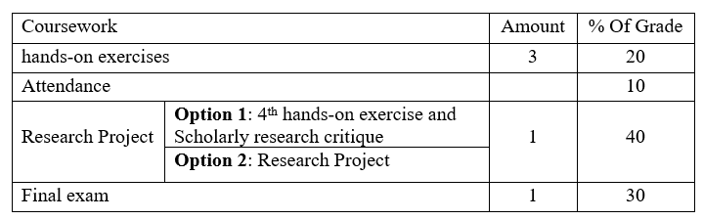
Grading
Course logistics (cont’d)
13
Notes:
Next, I will quickly go through the grading scheme.
There will be three hands-on exercises, which are focused on specific tasks pertaining to digital forensics.
Also, 10 percent of your final grade are allocated for your class attendance.
Also, we have a project worth 40 percent of your final grade. I will talk about the project in more details later.
Basically, you have two options: First, you can do one more hands-on exercise and do a critical review of one research paper. Second, you can work as a team, proposing a research project and completing it.
Regardless of the option you have, you will need to give a in-class presentation about the paper you have reviewed or your research project.
We also have a final exam, worth 30 percent of your final grade.

Slide 14

Hands-on Exercises
Hands-on Exercises
3
14

Slide 15


Course Project
15
Notes:
For the research project, you will have two options: First, you can do one more hands-on exercise and do a critical review of one research paper. Second, you can work as a team, proposing a research project and completing it.
Regardless of the option you have, you will need to give a in-class presentation about the paper you have reviewed or your research project.
Next, I will talk about the project in more details if you choose to do a research project in my class.

Slide 16
Course Project (cont’d)
A team of at most two people
The project is specialized in some specified digital forensics areas
Each team will present their studies on digital forensics and lead a short discussion on their studies in a conference-style presentation. Note that class demonstration & presentation is MANDATORY.
Only one report per group is required and everyone in the team is given the same score.
Report Due on the last day of classes for the term.
16
Notes:
If you choose to do a research project in my class, students may choose to work by themselves or in pairs (a team of at most two people)

Slide 17
Course Project (cont’d)
Research project topics:
Data Acquisition for Mobile Phones or IoT devices
File System Forensic Analysis
OS Forensics
Fake Content Forensics (e.g., fake news detection, image forgery detection, Deepfake video and audio detection)
Malware Forensics (e.g., Forensic Analysis of Ransomware, Javascript Malware, Wasm Malware)
17
Notes:
Research project topics include
Data Acquisition Methods for Mobile Phones or IoT devices
File System Forensic Analysis
OS Forensics
Fake Content Forensics (e.g., fake news detection, image forgery detection, Deepfake video and audio detection)
Malware Forensics (e.g., Forensic Analysis of Ransomware, Javascript Malware, Wasm Malware)
You should choose one which you have some background knowledge. Or, if you think you lack the background of the topic that you are interested in, you will have to build background knowledge as needed, which is very normal for graduate students.

Slide 18


Course Project (cont’d)
Course Project Final Report
3
Due on the last day of classes for the term
Class demonstration & presentation
15th , 16th week
2
Course Project Proposal
1
Due on 8th week
literature review & team
18
Notes:
There will be three important milestones related to course project.
Each team must submit a proposal, which is due in the 8th week. The proposal is not worth any marks, but it MUST be submitted and approved for the project grades to be counted. The reason I must approve your project is I want to make sure your chosen project and its scope is doable in one semester. I don’t want you to pick up a PhD’s research topic, which becomes kind of mission impossible for one semester. You have to know that a PhD student usually spends 4 years or even more completing their research.
Afterwards, you can work with your team member to complete your project, which is the second milestone. The final report is due on the last day of the class.
Also, each team must present their studies on digital forensics and lead a short discussion on their studies in a conference-style presentation. The presentation will be scheduled in the last two weeks, and the detailed presentation schedule will be decided later after the teams are formed.

Slide 19

Course Project (cont’d)
Course Project Proposals
Goals/Objectives:
What are we going to do?
Approach and Methodology
Summary:
What will we learn by doing this project?
19
Notes:
How a project proposal looks like?
There is no format requirement for the project proposal, but the proposal provides a brief description of the project, and must include
- Objectives: describe your objectives or goals,
- Project Plan (Approach and Methodology): you plan to use what approach and methodology to meet objectives,
- Summary/Conclusion: what will you learn by doing this project?
It also should list all project team members. You should only submit one proposal per team for the course project.

Slide 20

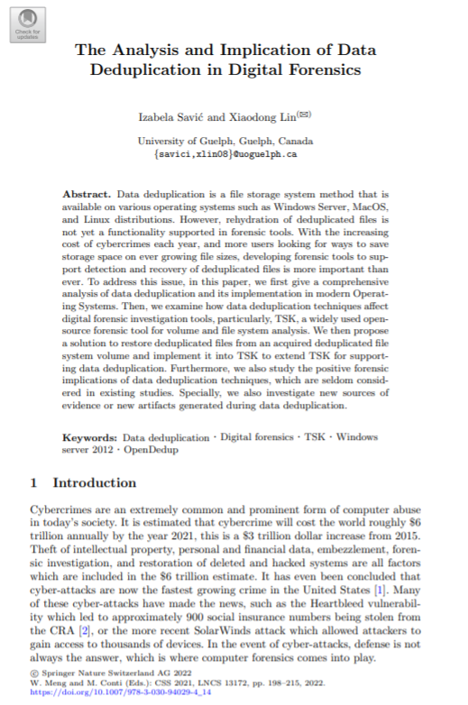
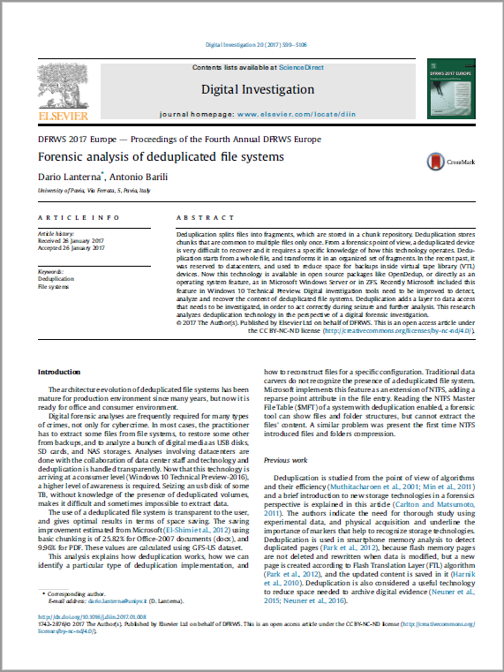
[1] Laterna D, Barili A. Forensic analysis of deduplicated file systems. DFRWS 2017 Europe. https://doi.org/10.1016/j.diin.2017.01.008
[2] I. Savić and X. Lin: The Analysis and Implication of Data Deduplication in Digital Forensics. In: 2021 International Symposium on Cyberspace Safety and Security (CSS 2021).
Notes:
Next, I would like to use a report from one of my former student as an example to show what a course research project could be.
Note that we are NOT talking about a major research contribution here.

Slide 21


Deduplicated File System Forensic Analysis
How Data deduplication works.
a process that eliminates excessive copies of data and significantly decreases storage capacity requirements.
It can be divided into 2 categories: Deduplication can be run as an inline process as the data is being written into the storage system (aka Inline deduplication) and/or as a background process to eliminate duplicates after the data is written to disk (aka post-processing deduplication).
Notes:
Nowadays, we start to witness increasing adoption of new storage technology into modern OS (e.g., data deduplication). In the deduplication process (aka intelligent compression or single instance storage), duplicate data is removed from the hard disk, leaving only one copy of the data to be stored.
Regardless of whether using inline or post-processing deduplication, both follow the same methodology.

Slide 22


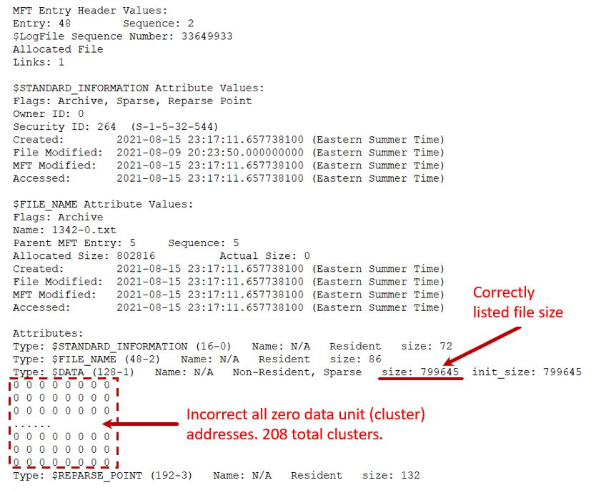
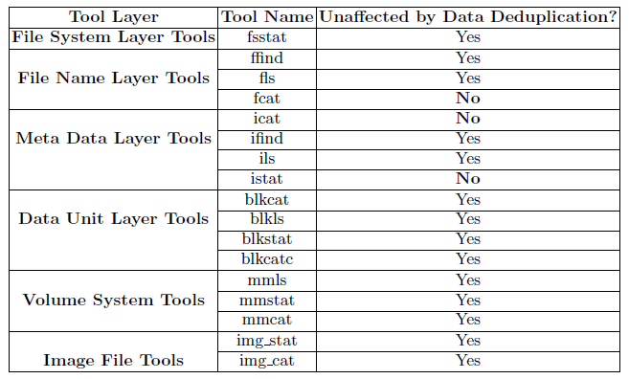

Deduplicated File System Forensic Analysis (cont’d)
(TSK)
istat
[1] I. Savić and X. Lin: The Analysis and Implication of Data Deduplication in Digital Forensics. In: 2021 International Symposium on Cyberspace Safety and Security (CSS 2021).
Notes:
While data deduplication is very useful, for example, eliminating redundant data, and driving down storage cost. But, it also introduces many challenges to us in the field of digital forensics. For example, as of today, but none of the major forensic tools supports data deduplication. For example, some tools of TSK, a widely used open source file system forensic tool kits, will fail.
[click]
This is an example output of the istat tool on a deduplicated file. It can be observed that the tool failed to display the addresses of data units occupied the file

Slide 23
Deduplicated File System Forensic Analysis (cont’d)
The first solution that comes to mind: recover files from file system volumes with data deduplication enabled when performing data acquisition from a data deduplication file system. It does not work because
It could possibly overwrite unallocated or deleted data (violation of “Principles of Evidence Collection and Preservation”) and is not always an available option if the unoptimized volume is too large to fit on the current disk
Investigators lack of experience in handling different data deduplication systems
Our solution: Acquire data from a deduplication enabled file system using the regular practice, and extend forensic tools (e.g., TSK) to support data deduplication.
[1] I. Savić and X. Lin: The Analysis and Implication of Data Deduplication in Digital Forensics. In: 2021 International Symposium on Cyberspace Safety and Security (CSS 2021).
Notes:
Our solution is during the data acquiring, we don’t check the status of data deduplicaition. Instead, we extend forensic tools (e.g., TSK) to support data deduplication.

Slide 24
Deduplicated File System Forensic Analysis (cont’d)
Enhanced istat
Notes:
This is an example of our enhancement to the istat tool.
The figure on your left side is the original output, whereas the one on your right side is the new output. You can see that the addresses of all the data units occupied by the deduplicated file are now displayed correctly.

Slide 25


Non-graded hands-on exercises
25
Notes:
Occasionally, I will also give some non-graded mini hands-on exercises for you to practice certain digital forensic tasks.
No submission is required for these exercises.

Slide 26
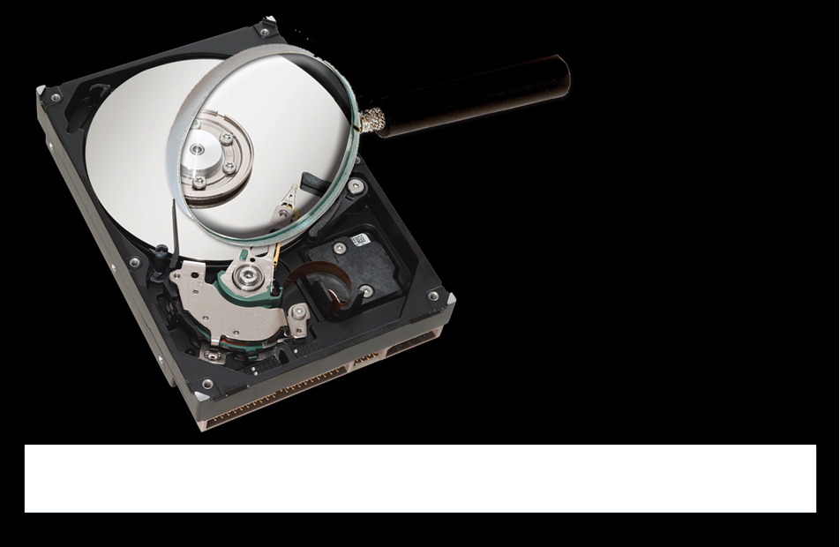
Introduction to Digital Forensics
Digital Forensics
Notes:
Next, I will start with an introduction to digital forensics.

Slide 27
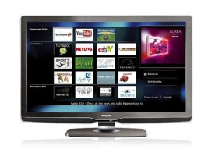
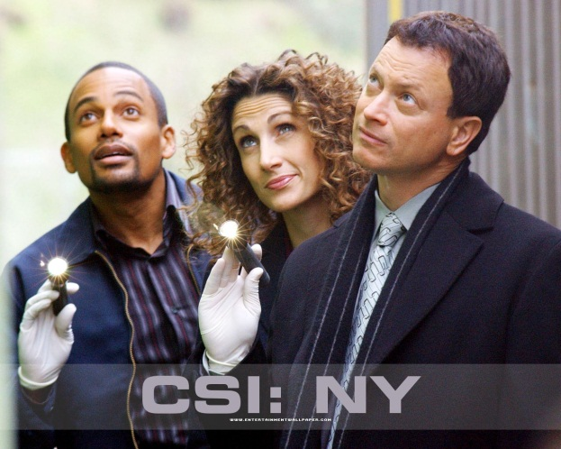

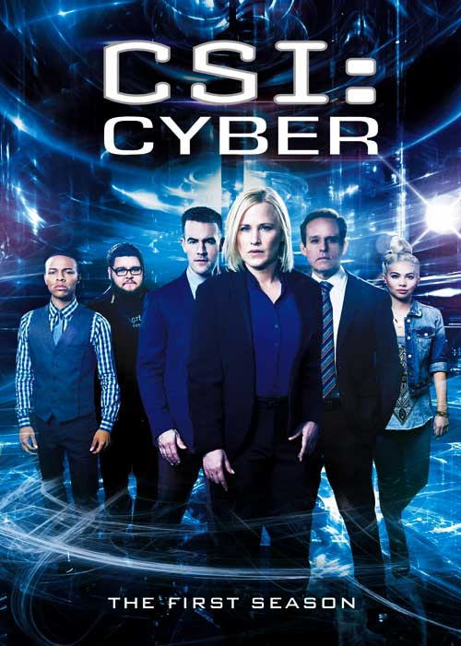



Notes:
You must have watched some detective TV shows or movies before.
You also like some or all of them.

Slide 28


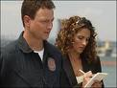
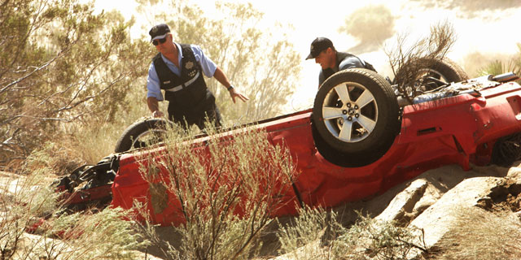
CSI: NY
(Crime Scene Investigation: New York)
Evidence!
Investigators
Crime scene
Notes:
CSI: NY (Crime Scene Investigation: New York) is my favorite. If you happen to watch one detective show before, the following scene must look familiar to you.
When a crime occurs, some detectives will be called on to the crime scene for investigation. They are looking for something, in particular evidence that will help to reconstruct what happened and how it happened and lead them to catch the bad guy.

Slide 29
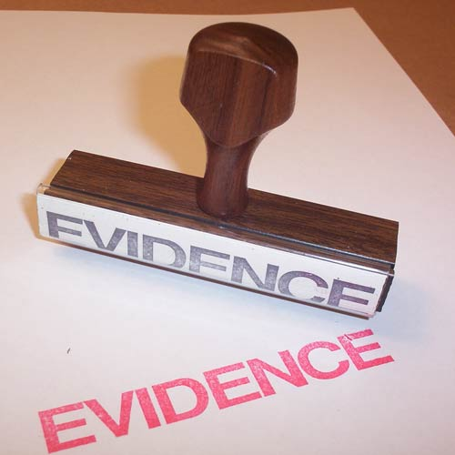
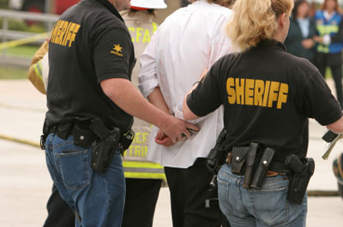
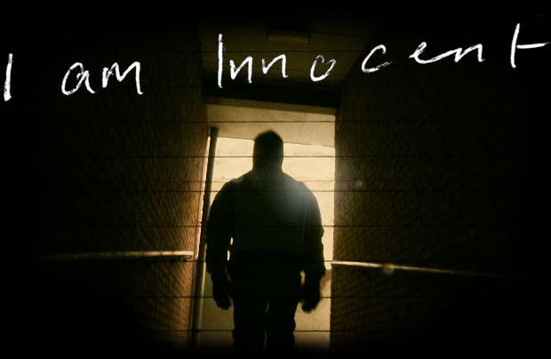
They are looking for forensic evidence, which could lead to identifying criminals. Also, forensic evidence can be also utilized to prove the innocence of those wrongly convicted of a crime.

Slide 30
Locard’s exchange principle
In forensic science, Locard's principle holds that the perpetrator of a crime will bring something into the crime scene and leave with something from it, and that both can be used as forensic evidence.
When a crime is committed, fragmentary (or trace) evidence needs to be collected from the scene. A team of specialized police technicians goes to the scene of the crime and seals it off, and collects forensic evidence, for example,
recording video and taking photographs of the crime scene, victim/s (if there are any) and items of evidence.
[1] https://en.wikipedia.org/wiki/Locard%27s_exchange_principle

Slide 31
Evidence at the scene
The next page contains images some students may find graphic and disturbing. Viewer discretion is advised.

Slide 32
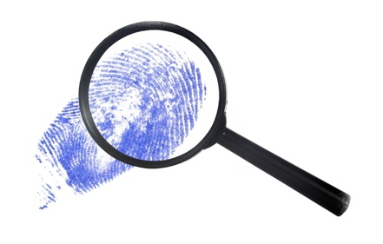
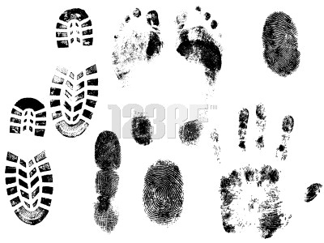



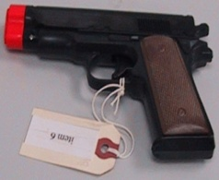
Evidence at the scene (cont’d)
*This page contains images some students may find graphic and disturbing.
Viewer discretion is advised.
Notes:
In the traditional investigations, they are looking for evidences such as fingerprint, blood sample, murder weapon.

Slide 33
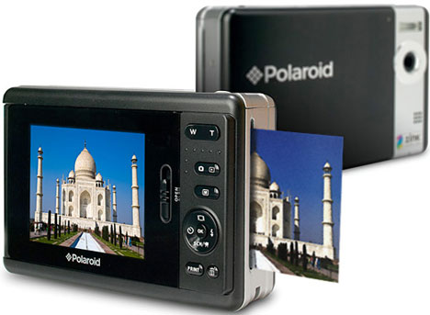

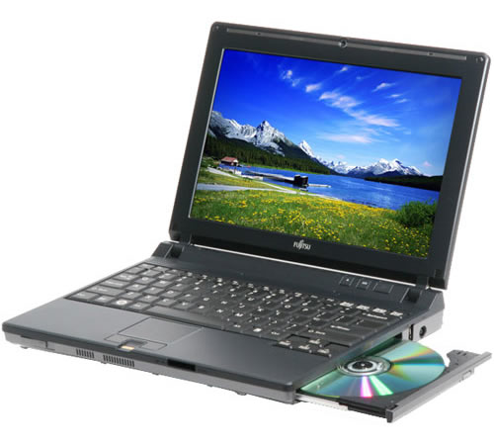

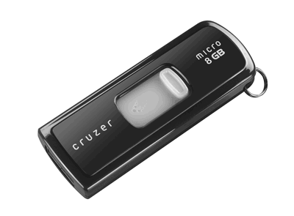
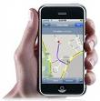
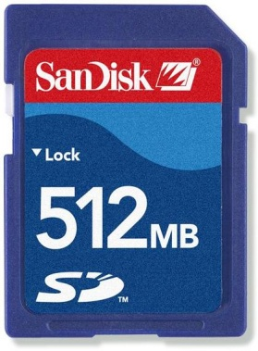
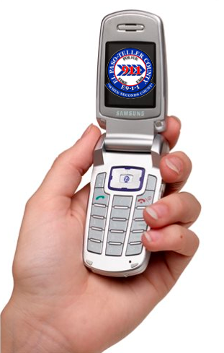
Dose of Reality: Digital Age
Notes:
Now we are living in a digital world, people increasingly continue to use electronic devices in their daily lives.

Slide 34
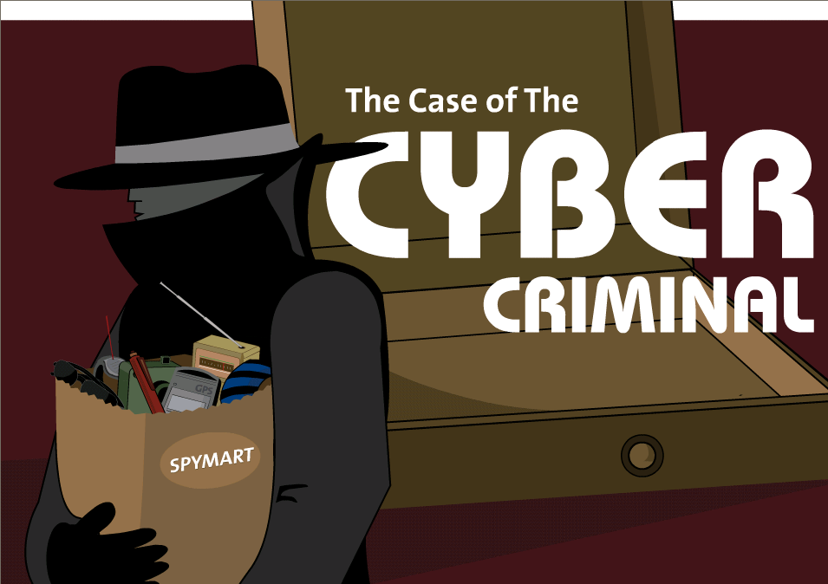

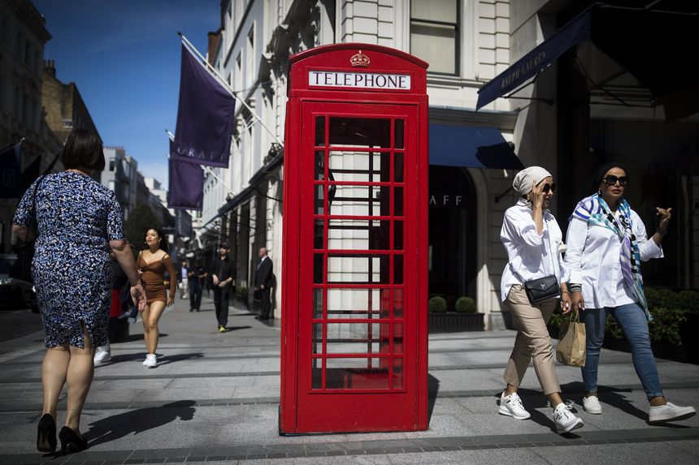

Dose of Reality: Digital Age (cont’d)
Doctored photos damage someone's reputation
“seeing is no longer believing”
Fraudsters Used AI to impersonate someone’s voice
[1] https://www.wsj.com/articles/fraudsters-use-ai-to-mimic-ceos-voice-in-unusual-cybercrime-case-11567157402
Notes:
Unfortunately, illegal activities also take on new forms through the use of digital devices or communication and computer network. Recent media coverage indicates that there is a rapid increase in cyber crimes, and it is expected to become increasingly frequent.
For example, you may be harassed or bullied online. Also, “seeing is no longer believing” anymore. Doctored or faked photos damage someone's reputation.

Slide 35
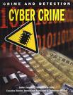

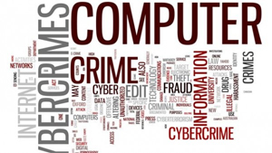
Dose of Reality: Digital Age (cont’d)
35
Notes:
However, investigating crime involving digital devices is no different to any other crimes, we need to find out who did it so we can prosecute wrongdoers or criminals.

Slide 36
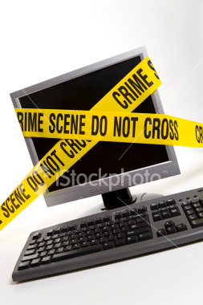
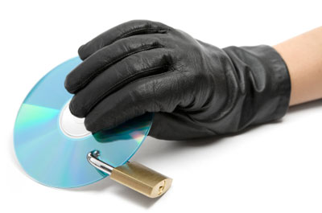
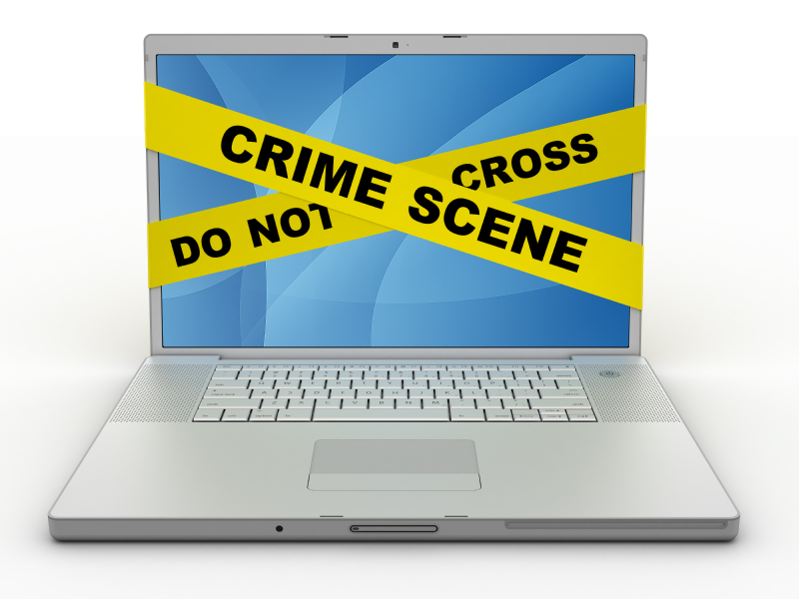
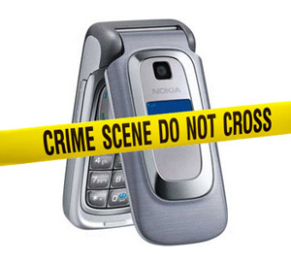
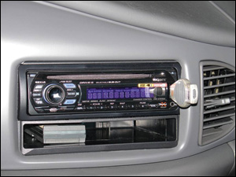


Digital Evidence at the scene
Notes:
So we are looking at collecting collect some different types of evidence during investigations and prosecute wrongdoers.
We are collecting digital evidence which can be collected from electronic devices such as computer, laptop, mobile phones, CD, USB drives.

Slide 37

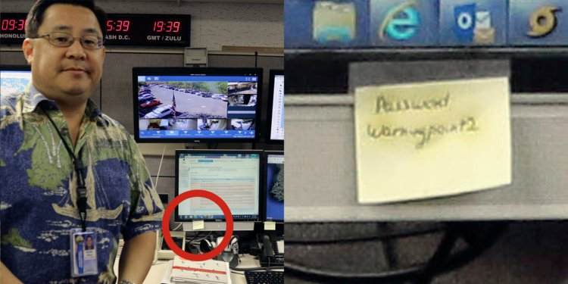
Digital Evidence at the scene
Toy and art USB drivers
A password for the Hawaii emergency agency was hiding in a public photo, written on a Post-it note ^{[1]}
[1] https://www.businessinsider.com/hawaii-emergency-agency-password-discovered-in-photo-sparks-security-criticism-2018-1
Notes:
Also, when collecting evidence at a digital crime scene, some precautions must be taken in order to ensure that everything useful has been gathered. For example, currently the fashion trend for electronic devices (e.g., USB flash drivers) is irregular appearances. Many electronics are manufactured with appearances that are different from their traditional appearances, turning into fashionable accessories. Examples of such USB drivers are shown here, for example, Toy and art USB drivers.
Another important thing to note is that not all digital-crime-related evidences are digital. For example, it is not unusual that people write down their passwords and place it somewhere they think it is convenient to find.

Slide 38

Dose of Reality:
Computer People are from Mars
Law Enforcement is from Venus
--Scott L. Ksander
Notes:
Investigating cyber crime or attacks? You may say that that is easy for me since I am a security expert. I know what happened.
Unfortunately, we and law enforcement are very different.

Slide 39
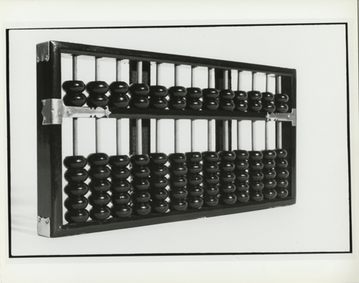
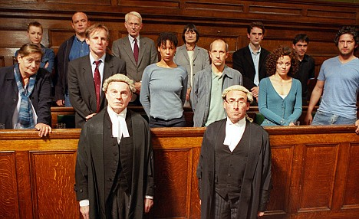
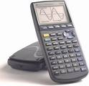


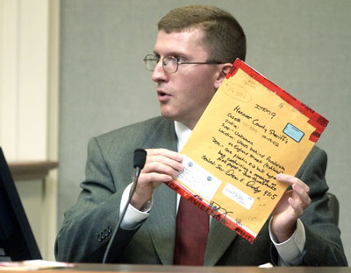


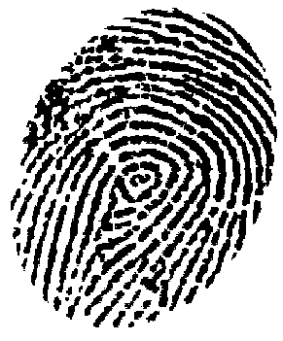

Here is your evidence your honor
Accepted!
39
Notes:
There are some challenges to present digital evidence in court.
[click]
There are some reasons for it: First, digital evidence are stored on a digital devices such as USB drive. Unlike the physical evidence like murder weapon (e.g., knife), which is very intuitive, digital evidence can not be directly perceived through its appearance.
Second, The Judge and Jury are usually not computer experts.
[click]
Therefore, you will have to present the evidence in a way which the law enforcement can follow. For example, a well-detailed report.

Slide 40






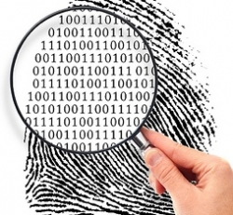
Look for forensic evidence, such as, fingerprint.
Look for digital forensic evidence, such as, deleted files.
40
Notes:
In the traditional forensic investigation, we Look for forensic evidence, such as, fingerprint.
Now, we are also looking for Look for digital forensic evidence, such as, deleted files.
They are complementary to each other.

Slide 41

Modern technology has produced a continuing revolution in forensic practices. Advances in forensic technology are giving us an unprecedented ability to solve cases.
41

Slide 42
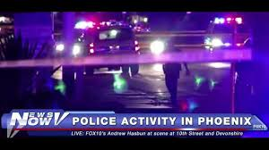
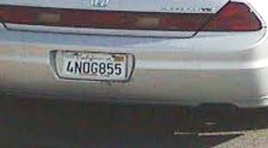
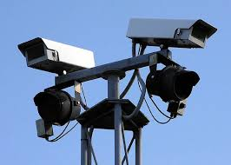
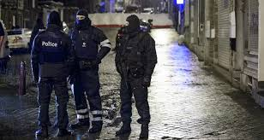
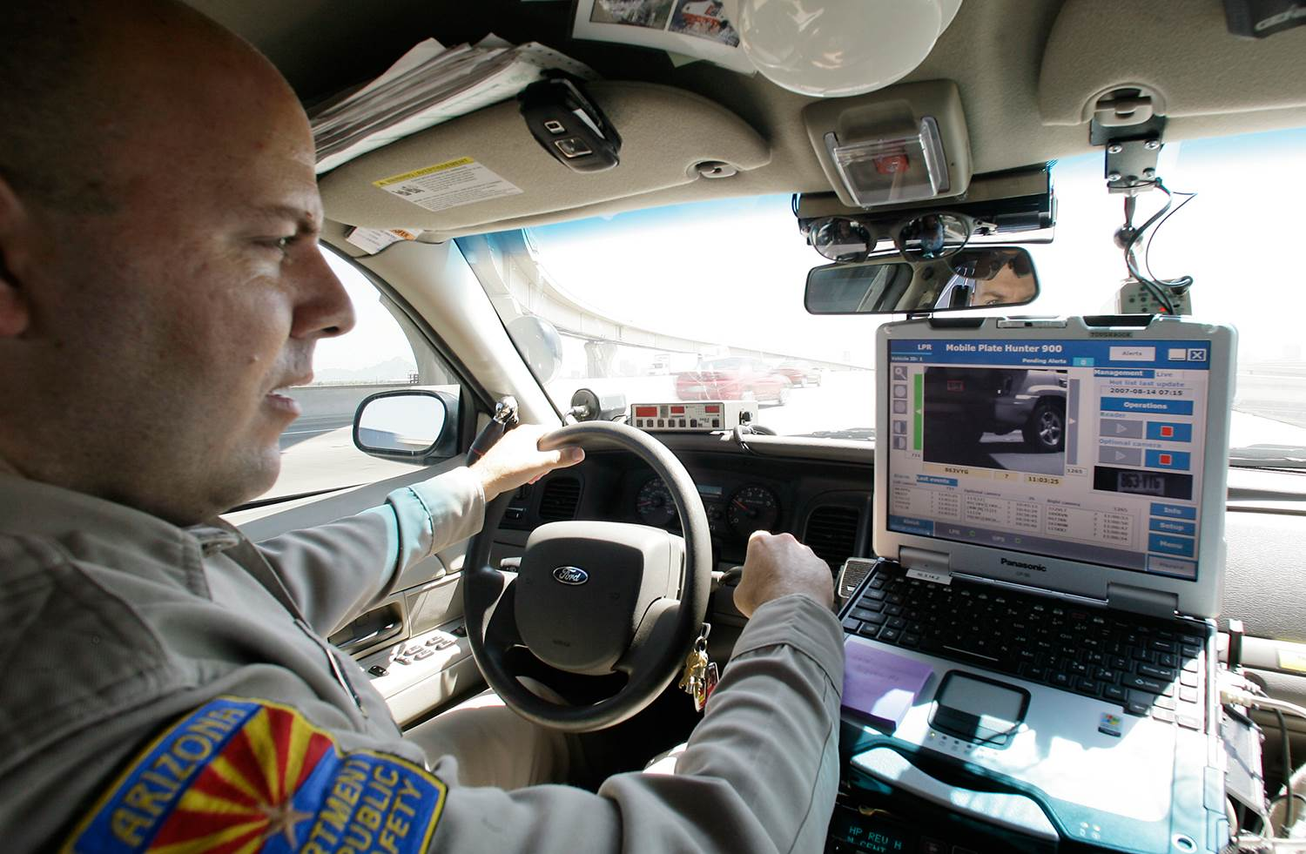
Automatic License Plate Recognition (ALPR) system
[1] C. Song and X. Lin, "Blurred License Plate Recognition based on single snapshot from drive recorder," In Proc. ICC 2015, London, United Kingdom.
Notes:
It is very common that you watch some TV news, saying that suspects sought are on the run with a car, and police officers want to locate and stop the suspect vehicle.
In the past, usually several scouts are sent out to some important road intersections, standing aside of road and looking for the suspect car.
Now, it becomes very common that police sitting inside their car, using a camera mounted on a police vehicle to automatically capture images of all license plates of the vehicles passing by.
The officer in the police vehicle will be alerted when a scanned plate matches the plate of the suspect car.
However, it is worth noting that automatic license plate recognition (ALPR) system raises fears of privacy violation and a high potential for abuse.

Slide 43
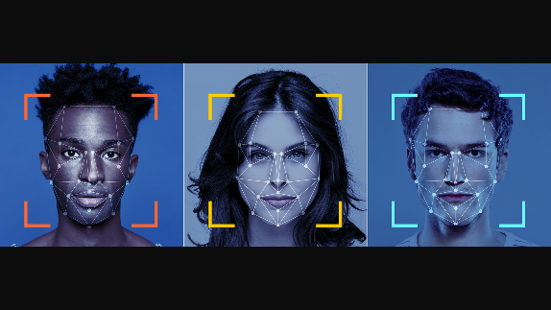
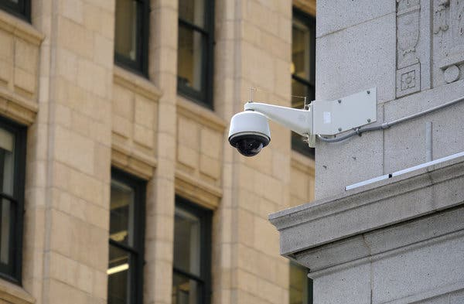
Facial recognition for identification of victims and suspects
facial images
Facial recognition technology has been widely used by law enforcement for identifying victims and suspects.
[1] Guelph police admit to using Clearview facial recognition tool now under federal, provincial investigation
https://www.toronto.com/news-story/10112673-guelph-police-admit-to-using-clearview-facial-recognition-tool-now-under-federal-provincial-investigation/
Notes:
Facial recognition technology has been widely used by law enforcement for identifying victims and suspects.
For example, in the photo here, there is a security camera taking photo of people walking in San Francisco’s Financial District. It is used by the police and other law enforcement agencies, for example, to identify victims and suspects.
It is a very powerful and efficient tool that, much like DNA analysis, offers a way to bring policing into the modern age and help catch wrongdoers or solve crimes.
However, similar to Automatic License Plate Recognition (ALPR), it is worth noting that facial recognition technology also raises fears of privacy violation and a high potential for abuse.

Slide 44

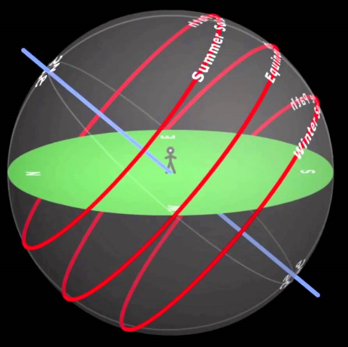
Dose of Reality:
Tracing Shadows
Shadows and Sunlight
The shadow you create by blocking sunlight changes through the day as the position of the sun in the sky changes.
Astronomy
90º
30º
44
Notes:
When you stand under the sun, you can observe your shadow.
The shadow you create by blocking sunlight changes through the day as the position of the sun in the sky changes.
You may remember some game you play when you are child, Tracing Shadows.

Slide 45
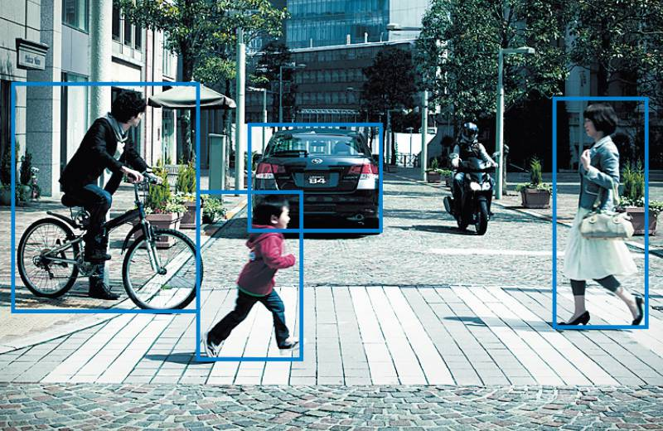
Determine Where a video was Taken
[1] Y. Zhou. Genetic sun shadow positioning model for digital forensics. Master's thesis, UOIT. 2017
45
Notes:
But there is another, often overlooked, way to use sun shadow for the purposes of digital forensics.
Specifically, we can calculate the shadow in a video to determine where a video is taken.
Of course, you may also know that GPS-enabled camera devices like smartphone record EXIF (Exchangeable Image File) data along with the video.
If the EXIF data’s there, it’s easy to trace where the video was taken.
However, the EXIF data would probably be stripped off or removed by tech-savvy criminals.
EXIF stands for Exchangeable Image File, which is an image format.
The EXIF data contains a ton of information, including where the picture or video was taken (GPS coordinates).

Slide 46


Data Exfiltration Detection and Prevention
[1] M. Guri, AIR-FI: Generating Covert Wi-Fi Signals from Air-Gapped Computers. https://arxiv.org/abs/2012.06884
[2] Michael Hanspach and Michael Goetz. On Covert Acoustical Mesh Networks in Air. https://arxiv.org/pdf/1406.1213.pdf
[3] Z. Ba, et al., Learning-based Practical Smartphone Eavesdropping with Built-in Accelerometer, NDSS 2021
46
Notes:
You have a well-protected computer which stores some confidential data. But why and how these confidential data are still stolen.
Sometimes, you may be wondering why your computer is not even connected to the Internet, but your data is stolen from your computer! What happened?
Unfortunately, computer hackers can find many creative ways or techniques to exfiltrate or transfer confidential data, which can be difficult to detect.
For example, turning RAM into Wi-Fi cards to steal data from a disconnected computer. Or,
using speakers or headphones over ultrasonic waves or turning power supply into speaker to exfiltrate data (over an acoustic channel) from air-gapped devices.
It becomes increasingly important to detect and prevent data exfiltration.

Slide 47
Computer Forensics
a.k.a digital forensics, media analysis, IT forensics
No matter what the computer crime, there will always be incriminating evidence. Computer Forensics will find it.
47
Notes:
No matter what the computer crime, there will always be incriminating evidence. Computer Forensics will find it.
So what is Computer Forensics?

Slide 48



Dose of Reality:
Cybersecurity and cryptography
Forensic science
OS and file system
Computer Science
AI/ML
Computer Network
Data Structures and Algorithms
……
Notes:
Digital forensics intersects with many disciplines.
It draws upon multiple fields of knowledge, such as almost very area in CS, such as Cybersecurity and cryptography, OS, AI/ML, computer networking works, data structures and algorithms, and forensic science.
That being said, my class focuses more on purely technical aspects.

Slide 49
Computer Forensics
Computer forensics is a branch of forensic science pertaining to legal evidence found in computers and digital storage mediums.
It is concerned with extracting digital evidence from suspect systems, doing it in a way that preserves its legal worth, using that evidence to construct and prove hypotheses about crimes, and ultimately, giving prosecutors the proof they need to bring criminals to justice.
It is also known as digital forensics.
The goal of computer forensics is to explain the current state of a digital artifact. The term digital artifact can include
a computer system, a storage medium (such as a hard disk or CD-ROM), an electronic document (e.g. an email message or JPEG image) or even a sequence of packets moving over a computer network.
A good example state can be webserver crash. The explanation can be as straightforward as "what information is here?" and as detailed as “what is the sequence of events responsible for the present situation?”
49
[1] Computer forensics. http://en.wikipedia.org/wiki/Computer_forensics
Notes:
Technically speaking, computer forensics is a branch of forensic science pertaining to legal evidence found in computers and digital storage mediums.

Slide 50






Real world example
My account is emptied! Someone hacked into my online banking account!
50
Notes:
Next, let’s take a real world example to see how useful a digital forensic investigation is.
Suppose you as a customer support of RBC, receive a call from one customer, complaining that his account is emptied. Someone hacked into his online banking account! This is a serious issue, which may lead to the public's trust declining in your online banking system.
So you want to help out by investigating the incident, though it is not the fault on your side since you know your online system is secure.

Slide 51




Real world example (cont’d)
http://www.basecc.co.kr/js/a.html
Contact the bad guy's ISP and obtain his contact data
51
Notes:
The customer told you that he received an "Your RBC online banking account is currently locked" email from RBC, which asks the customer to take an immediate action in order to unlock it. The customer followed the instructions from the email and clicked on a link embedded in the message to identify himself to the online system. But, his account is emptied now.
You know the customer has been attacked by a phishing email.
So you asked the customer to forward you the email.
[click]
You check the link embedded in the message, and find it is not the RBC web link. If you ping two web links, the IP addresses are very different.
It conformed that it is a phishing attack.
[click]
Then, you find out the ISP based on the IP address used by the phishing web site. Afterwards, you can contact the bad guy's ISP and obtain his contact data.
[click]
Finally, you can contact the local law enforcement to have the bad guy arrested.

Slide 52



Computer Forensics in Action
Chandra Levy was a Washington, D.C. intern who disappeared on April 30, 2001. She had used the web and e-mail to make travel arrangements and communicate with her parents. Information found on her computer led police to search most of Rock Creek Park (a large urban natural area with public park facilities that bisects Washington, D.C), where her body was eventually found one year later by a man walking his dog.
Rock Creek
Notes:
We are now taking a look at Computer Forensics in Action.

Slide 53

Computer Forensics in Action (cont’d)
Dennis Rader, a.k.a. BTK Killer, was convicted of a string of serial killings that occurred over a period of sixteen years. Towards the end of this period, Rader sent letters to the police on a floppy disk. Metadata within the documents implicated an author named "Dennis" at "Christ Lutheran Church"; this evidence helped lead to Rader's arrest.
Aside from uncovering evidence to assist the prosecution in high-profile murder cases, an in-depth knowledge of computer forensics is integral when presenting digital evidence for legal proceedings.

Slide 54




Computer Forensics in Action (cont’d)
Notes:
What if you receive an offensive anonymous document?
It is very common that anonymity technologies are used by criminals to do bad things.
However, you really want to find out who did it.
[click]
You check the metadata of the document, and notice that the author’s name is Xiaodong Lin. So you know “Xiaodong Lin” would probably be the bad guy behind it.

Slide 55

Computer Forensics in Action (cont’d)
[1] Sarah Palin email hack. http://en.wikipedia.org/wiki/Sarah_Palin_email_hack
Notes:
Next, we take a look at another cyber attack story about Sarah Palin’s personal yahoo email account which had been hacked.
Since Sarah Palin is then US vice president’s candidate, FBI started to investigate the incident.

Slide 56
Sarah Palin email hack
Network tracing
The incident is reported to the law enforcement authority, and the FBI and Secret Service started responding to the incident reported.
The FBI and Secret Service began investigating the incident immediately. The hackers’ electronic trail has been traced to a server site in Chicago. The server logs at that site revealed someone login from a residence where David Kernell, a 20-year-old economics student at the University of Tennessee, lives.
FBI agents served a federal search warrant at the David Kernell's residence in the early morning hours of September 14, 2008. Agents spent 1.5 to 2 hours taking pictures of everything inside his apartment. Kernell's three roommates were also subpoenaed and expected to testify.
Kernell was indicted by a Tennessee grand jury on October 8, 2008, for his connection to the illegal hack. This unauthorized access is being prosecuted as a felony, which if proven in court is punishable by a maximum of five years in prison and a $250,000 fine.
Log Analysis
Notes:
The hackers’ electronic trail has been traced to a server site in Chicago. The server logs at that site revealed someone login from a residence where David Kernell, a 20-year-old economics student at the University of Tennessee, lives.
FBI agents searched David’s apartment, and prosecuted him for illegal hacking.

Slide 57







Notes:
There are many types of digital evidence which can be used to solve crimes. Digital forensics is very useful.

Slide 58
Digital Investigation Fundamentals
Notes:
Next, we will study the fundamentals to digital Investigation.

Slide 59
Digital Investigation Foundations
A digital investigation begins when a digital device is involved in an incident or crime
The device was used to commit a crime
Or the device was used to violate a policy or the law
The nature of digital investigation requires us to use a variety of technology during an investigation
The investigation develops and tests hypotheses that answer questions about digital events
Notes:
So what is digital investigation? A digital investigation begins when a digital device is involved in an incident or crime.
For example, The device was used to commit a crime
Or the device was used to violate a policy or the law
As such, the nature of digital investigation requires us to use a variety of computer technology during an investigation.
Similar toa traditional forensic investigation, a digital investigation develops and tests hypotheses that answer questions about digital events.

Slide 60



Digital Investigation Foundations (Cont’d)
Notes:
For example, when a crime occurs, the police may have a long list of suspects. Then, they will need to launch a digital investigation to narrow list of suspects down to a few suspects.

Slide 61
Digital Forensics and Digital Investigation
Forensics (forensic science) is the term used to relate the “use of science or technology in the investigation and establishment of facts or evidence in a court of law”^{[1]}.
A digital investigation is a process where we develop and test hypotheses that answer questions about digital events. Digital evidence is a digital object that contains reliable information that supports or refutes a hypothesis
Digital forensics or Digital Forensic Investigation is a more restricted form of digital investigation which involves using legal requirements for submitting evidence into a court of law.
Digital forensics (Computer forensics) is a branch of forensic science (or the digital version of Forensic science) pertaining to legal evidence found in computers and digital storage mediums.
[1] The American Heritage® Dictionary of the English Language, Fourth Edition.
Houghton Mifflin Company.

Slide 62

digital investigation
legal requirements
digital forensics
+
=

Slide 63
Digital Evidence
Digital evidence refers to any information that is stored or transmitted in a machine-readable form, and maintains enough integrity and legitimacy to be used in a court of law. It is also known as electronic evidence, and can be further classified by the context of the evidence, in either legal or investigative context.
Examples of digital evidence
e-mails, digital photographs, ATM transaction logs, word processing documents, instant message histories, files saved from accounting programs, spreadsheets, Internet browser histories, databases, the contents of computer memory, computer backups, computer printouts, Global Positioning System tracks, logs from a hotel’s electronic door locks, and digital video or audio files.
63

Slide 64


Forensic evidence cannot be modified or changed.

Slide 65
Forensic evidence cannot be modified or changed.
Modification Attack
Notes:
Unfortunately, digital evidence can be easily changed and modified.

Slide 66




Forensic evidence cannot be modified or changed.
Modification Attack
How many kittens are sitting on the street? How many umbrellas?
[1] Detecting Forged (Altered) Images.
http://articles.forensicfocus.com/2013/08/22/detecting-forged-altered-images/
Notes:
If you are talking about a hardcopy of a document, it is easy to identify the modification. However, it is very hard to identify the modification of an electronic document, for example, a photo, especially, using naked eye.
For example, in the pictures here, how many kittens are sitting on the street? How many umbrellas? Actually, these two pictures have been modified by adding kitten or umbrella.
We need to find a way to address this issue.

Slide 67


Dose of Reality:
Notes:
Next, let’s take a look at what we have done every day.
We download and install software everyday. For example, putty is my favorite tool, and I want to download and install it when I have a new computer.
Now it becomes very dangerous when we download and install software from the Internet.
How can I know I download and install the authentic copy of putty
That is why we only download and install software from trusted sources.
So we need to make sure that we download and install the authentic copy of the software.
If you go to the download site for putty, you will notice that they post the hash value (e.g., MD5) for the putty. It means after you download putty, and you can computer another hash value of your downloaded putty. Afterward, you compare the resulted hash value with the one posted on the download website. If they match, you know you have downloaded the authentic copy. Otherwise, you know you may download a malware.

Slide 68

Dose of Reality: (cont’d)
bind the malware to legitimate files (using the malware binder called YAB)
[1] Binders and Malware
http://www.windowsecurity.com/articles/Binders-Malware-Part1.html
http://www.windowsecurity.com/articles/Binders-Malware-Part2.html
http://www.windowsecurity.com/articles/Binders-Malware-Part3.html
Notes:
Why we need to make sure that software we download is authentic. This is because the attacker may modify a popular software, and even worse "bind" a malicious program with a harmless program, resulting in a single executable. It is also known as binder, for example, using YAB (Yet Another Binder)

Slide 69


Hash Function
Hash function properties:
Produces a fixed-length output (hash value or msg digest or fingerprint)
H(x) is relatively easy to compute for any given x, but computationally infeasible to find x such that H(x) = h, known as One-way
computationally infeasible to find any two messages m and m’ such that H(m) = H(m’), known as collision resistant
hash function H
.
message
Hash value or message
“digest”
m
.
.
x
.
m’
x’
bit strings of any length
n-bit bit strings
69
Notes:
The purpose of a hash function is to produce a “fingerprint” of a file, message, or other block of data. To be useful for message
authentication, a hash function H must have the following properties:
First, it produces a fixed-length output (hash value or msg digest or fingerprint) when given an arbitrary length of message
Second, for a hash function H(x), it is relatively easy to compute the hash value for any given x, but computationally infeasible to find x such that H(x) = h, known as One-way property
Third, it is computationally infeasible to find any two messages m and m’ such that H(m) = H(m’), known as collision resistant property. collision resistant property is very important for security.

Slide 70
Hash Function (cont’d)
Data integrity = data has not been altered since creation time
modification
hash function H
.
.
message
m
x
.
.
m’
x’
n-bit bit strings
Notes:
The hash function can be used to ensure data integrity.

Slide 71
Common Hash Functions
MD5
128-bit output
Designed by Ron Rivest, used very widely
Collision-resistance broken (summer of 2004)
SHA-1 (Secure Hash Algorithm)
160-bit output
US government (NIST) standard as of 1993-95
Also the hash algorithm for Digital Signature Standard (DSS)
SHA-256 algorithm generates a 256-bit hash value
71
Notes:
Some common hash functions are MD5, SHA-1, and SHA-256.
I would like to point out that you should avoid using MD5, which is already broken.

Slide 72

Chain of Custody
Evidence must be strictly secured during its life cycle (e.g., starting when found, seized and acquired at a crime scene). In addition, the Chain of Custody needs to be clearly documented.
You should be able to clearly describe how the evidence was found,
how it was handled and everything that happened to it.
For example, in the courtroom, the defendant may question the chain of custody of the evidence it can be proven that the knife in the evidence room is the same knife found at the crime scene.

Slide 73

Creating & Maintaining Digital Chain of Custody
One of the key aspects of conducting digital forensics pertains with the proper collection and authentication of the evidence.
Facing the challenge from the defendant questioning the chain of custody of the evidence it can be proven that the hard disk image you are working on and presented in the evidence room is the same one acquired from the hard disk found at the crime scene.

Slide 74


Creating & Maintaining Digital Chain of Custody (cont’d)
Notes:
Suppose that you find a USB Flash Drive at the crime scene

Slide 75

Creating & Maintaining Digital Chain of Custody (cont’d)
Investigator Paul
Notes:
You will need to document it. For example, the appearance of USB flash drive, and most importantly, the hash value of the disk image.

Slide 76



Computer forensics investigation Procedure
Find the name of the last user to log onto this computer.
Digital Crime Scene
Notes:
Next, let’s take a look at a standard Computer forensics investigation Procedure.
Suppose you are called onto a crime scene, and find out that a computer has been used recently. You want to Find the name of the last user to log onto this computer.
Obviously, there are many ways to figure it out. For example, you can take a look at surveillance video or user login history in system log.
no matter which way you go, we will need to follow a standard Computer forensics investigation Procedure.

Slide 77
Computer forensics investigation Procedure (cont’d)
[1] X. Lin, Introductory Computer Forensics: A Hands-on Practical Approach, November 2018, Springer
Notes:
There exist many methodological (procedures) models which have been developed in the field of digital forensics.
such as KRUSE and HEISER model, Yale University Model. I will introduce a model I have developed, which has
three main stages and every stage has some phases should be completed together at that stage.

Slide 78

Computer forensics investigation Procedure (cont’d)
In Preparation Stage
Notes:
The first stage is preparation stage.

Slide 79

CSI: NY (Crime Scene Investigation: New York)
Notes:
If you still remember the detective TV show or movie you have watched, you may remember that when a crime occurs, some detectives will be called on to the crime scene for investigation. They are looking for evidence.
However, they are using some equipment to pick up the evidence.

Slide 80






……
Don’t forget yours!
Notes:
Similarly, in a digital investigation, we also need tools, but will be different from the traditional investigative equipment. Instead, you will need laptop, blank CD, printer, network cable, storage device, etc.

Slide 81


Digital Forensics Tools
Commercial Packages
Encase
Forensics Tool Kit (FTK)
Open-Source Software
The Sleuth Kit (TSK) / Autopsy by Brian Carrier
A widely used File System Forensic Analysis toolkit
[1] List of digital forensics tools
https://en.wikipedia.org/wiki/List_of_digital_forensics_tools
Notes:
Besides hardware, also, you will need forensic software or toolkits.

Slide 82


Build Your Own Forensic Workstation
Forensic Workstation
(Kali Linux)
The Sleuth Kit (TSK) / Autopsy
[1] Lin X. (2018) Building a Forensics Workstation. In: Introductory Computer Forensics. Springer, Cham. https://doi.org/10.1007/978-3-030-00581-8_3
Notes:
Technically, you are building a forensic workstation which has all the needed toolkits installed on it.
In our class, we simply use Kali Linux, which already has TSK installed.

Slide 83

Build Your Own Forensic Workstation (cont’d)
The Sleuth Kit (TSK) / Autopsy
[1] Vinay Gurram. Introduction to The Sleuth kit (TSK).
https://gurramvinayiiit.files.wordpress.com/2016/11/introduciton-tothe-sleuthkit.pdf
Notes:
For example, we will use TSK to analyze a file system image. TSK contains many tools, and we will start to introduce and use them later.

Slide 84
Computer forensics investigation Procedure (cont’d)
In Crime Scene Stage
Digital Crime Scene
Notes:
When you are called onto a crime scene, you may find some electronic devices at the scene. Now we are at Crime Scene Stage.

Slide 85
Digital Crime Scene Investigation
Collection
Preservation
Collection
The standard methodology for collecting the digital evidence, while maintaining its integrity, is to create an image of the device.
Preservation
Goal: Reduce the amount of evidence that is overwritten
Notes:
Then, you start a digital investigation. You will first need to collect the digital evidence, while maintaining its integrity, is to create an image of the device. Also, you will have to make sure that you reduce the amount of evidence that is overwritten.

Slide 86




Apply hash function to the data, and document the hash value
Acquiring Data
A Disk Image
Notes:
86
The most popular way to collect digital evidence is to create a disk image, which will be detailed when we introducing Data Acquisition
Also, in order to ensure integrity of disk image, which is for forensic purposes, we will need to apply hash function to the data, and document the hash value.

Slide 87

Computer forensics investigation Procedure (cont’d)
In Digital Evidence Lab Stage
Notes:
Digital evidence will be brought into Digital Evidence Lab for analysis.

Slide 88
Computer forensics investigation Procedure (cont’d)
In Digital Evidence Lab Stage
Examining and analyzing collected evidences
Reconstructing a Crime Scene by determining the sequence of events about what occurred during and after a crime
Presenting the evidences

Slide 89


Evidence
Searching Phase
When an incident occurs, investigators may have proposed all sort of hypotheses to explain why and how the incident have occurred and who did it
Goal: Find data to support or refute hypotheses
The theory behind the searching process is fairly simple. We define the general characteristics of the object for which we are searching and then look for that object in a collection of data. .
Example techniques: keyword search, timeline analysis, searching known files based on their hash values (or File Signature Searching Forensics)
Notes:
When an incident occurs, investigators may have proposed all sort of hypotheses to explain why and how the incident have occurred and who did it
You will need to analyze digital evidence to support or refute hypotheses.
Some example techniques which could be used include
searching a keyword, their temporal data, such as the last accessed or written time and signatures in their content, File Signature Searching Forensics ( searching known files based on their hash values)

Slide 90

(Cont’d)
Evidence
Searching Phase
File Signature Searching Forensics
Search for known files by comparing the MD5 or SHA-1 hash of a file's content with a hash database such as the National Software Reference Library (NSRL) (http://www.nsrl.nist.gov).
NSRL* has been created by The National Institute of Standards and Technology (NIST). It is a hash database of known files, which could be good files, such as Windows system files, or bad files, for example, malware. The NSRL contains hashes of files that are taken from software installations and other "known" files from the Internet. The NSRL can be imported into several forensic applications.
*The NSRL is sold with a yearly subscription and has quarterly updates.
Notes:
Next, let’s take a look at how to search for known files by comparing the MD5 or SHA-1 hash of a file found in the suspect’s computer with a hash database such as the National Software Reference Library (NSRL).
NSRL* has been created by The National Institute of Standards and Technology (NIST). It is a hash database of known files, which could be good files, such as Windows system files, or bad files, for example, malware.

Slide 91



Evidence
Searching Phase
Search for a known file based on its signature
Alert
Bad
Hash (or signature)
Hash (or signature) search
hits
Good
Ignore
Alert Database
Ignore Database
Notes:
Particularly, we can create two hash databases, Alert Database and Ignore Database.
Ignore Database contains good files, such as Windows system files, whereas Alert Database contains bad files, for example, malware.
In order to determine whether a file found in the suspect’s computer is good or bad, we can first compute the hash value of the file and then query two hash Databases. If the query is hitting the Alert database, we know it is a bad file.
If the query is hitting the Ignore database, we know it is a good file.

Slide 92




Crime scene reconstruction
When an incident occurs, investigators use the evidence that they found and determine what events occurred in the system.
Goal: Determine what events occurred in the system
Notes:
At the crime scene reconstruction phase, investigators use the evidence that they found and determine what events occurred in the system.

Slide 93

Presentation Phase
Here is your evidence your honor
93
Notes:
At the Presentation phase, investigators have to present the evidence in a way which the law enforcement can follow. For example, a well-detailed report.
There are some challenges to present digital evidence in court.
There are some reasons for it: First, digital evidence are stored on a digital devices such as USB drive. Unlike the physical evidence like murder weapon (e.g., knife), which is very intuitive, digital evidence can not be directly perceived through its appearance.
Second, The Judge and Jury are usually not computer experts.

Slide 94

Discussion
What is the difference between Digital Forensics and Digital Investigation?

Slide 95
Reading materials
Chapters 1, 2 and 3
IETF RFC 3227: Guidelines for Evidence Collection and Archiving. Feb. 2002. http://www.rfc-archive.org/getrfc.php?rfc=3227
How to Keep a Digital Chain of Custody. http://www.csoonline.com/article/220718/How_to_Keep_a_Digital_Chain_of_Custody
Chain of Custody: Authenticating Digital Evidence. http://www.criminallawlibraryblog.com/2009/02/chain_of_custody_authenticatin_1.html

Slide 96
Acknowledgements
Portions of this course design, organization, policies, syllabus, etc. came from Dr. Brian Carrier (The Author of The Sleuth Kit (TSK)), Dr. John A. Hamilton, Prof. Gordon Russell, Prof. Patrick Vilkinofsky, Prof. Scott L. Ksander, and Prof. Nick Sumner.

